Slide 1
JHU/APL Adaptability Technical Review
6/11/15
Joe Kelleher, PjM
Amy J. Haufler, Ph.D., TechLead
Kevin Ryan
Felipe Westhelle
Mark Weyrick
Project Team:
James Gavrilis
Collin Kaufman
Mary Luongo
Theodore Plettner

Slide 2
Definition of Adaptability
AWG’s definition of adaptability
Adaptability is an effective change in behavior in response to an altered situation while operating within the commander’s intent.
Behavior – measureable
Altered situations – stimuli
Commander’s intent – criteria for success
Notes:
AWG AWALP Handbook

Slide 3
Overarching Project Assumptions
Study Question:
What is adaptability?
Can it be measured in an individual?
If so, what are the metrics to measure adaptive behavior?
Guidance from COL Petkosek:
Employ a rigorous approach
Collect objective data to produce a defensible analysis
Conduct primary research
Milestones
Brief to TRADOC leadership will focus on status, study design, and expected outcomes

Slide 4
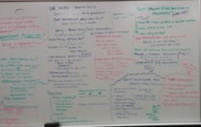
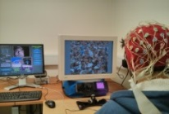
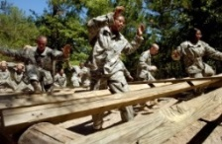



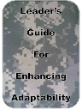

Overview of the Three Phased Study Approach
JUNE
2015
SEPT
2015
6 Months
APR
2016
Time
3-4 Months
4 Months
Phase 1
Phase 2
Phase 3
State of the Practice
Comprehensive review of current program materials, prior assessment efforts/findings, interviews and field observations.
Pilot Study and Validation
Execute a pilot study (n = 15-20) informed by the study of the state of the practice and recommendations from Phase 1.
Adaptability Study
Deploy a full study of adaptability in an authentic military sample (n ~ 40-50) informed by the pilot study and to include multiple levels of measurement.
Confirm what is known about adaptability.
Identify the knowledge/programmatic gaps relative to the study question.
Provide a course of action to address the gap and answer the question.
Validate the study design, measures, tasks and analysis pipeline by the conduct of a pilot study (n = 15-20).
Includes multiple levels of objective measurement, modes of measure, standard referent measures and adaptability field-relevant tasks.
Answers the question ‘what is adaptability and what are the metrics to measure adaptability’ in a study with sufficient power to determine statistical significant differences.
Provides in-depth analysis of results, discussion, and implications to AWG and TRADOC
What is learned
Access to SMEs
Facilitate observations and in-depth interviews
Provide AWG Adaptability materials and summaries
Review and input on field task design
Observations of the tasking for validation of relevance to AWG materials
Participant recruitment/scheduling and providing facilities/resources
Data collection scheduling priority to achieve study completion
Burden to AWG
APL Progress
Notes:
A 3 phased project will be conducted over the remaining FY15 and through FY16.
The purpose of phase 1 is ….. As a result we will learn …… and AWG will be involved by providing access to SMEs

Slide 5







Collaborative Approach
Multi-disciplinary Team:
Amy Haufler Ph.D., Kinesiologist, Neuroscience
Kevin Ryan: Operations Research Analyst
Mary Luongo: Biomedical Systems Engineer
Mark Weyrick: Mechanical Engineer
James Gavrillis: Army Adaptability SME, JSO
Felipe Westhelle: International Relations
Collin Kaufman: Bioengineering
Theodore Plettner: International Relations
APL
AWG
Scientific Advisory Panel
Joe Moran, PhD, Cognitive Scientist
US Army Natick Soldier Research,
Development and Engineering Center
Frederick Gregory, PhD, Program Manager
Neurophysiology and Cognitive Neuroscience
Army Research Office
Martin Bink, PhD, Research Psychologist
US Army Research Institute
- AWG Adaptability SMEs
Easy Squadron – AWALP, ASLTE, Cadet Command training
Dog Squadron – Assessment and Evaluation
Access to Adaptability SMEs
Facilitate engineering evaluation and data collection
Notes:
20+ yrs in the Army;

Slide 6
Phase 1: State of the Practice
GAP
Objective: Complete a comprehensive review of current program materials, prior assessment efforts and findings, interviews, and field observations to facilitate an understanding of the Army’s perspective and need for adaptability.
State of the Practice
Adaptable behavior…
…Requires execution of innovative, challenging, problem solving
…Involves self-reflection, self-awareness, and self-reliance
…forces soldiers to optimally perform under conditions of uncertainty
State of the Art
Adaptability in the Army…
….Adaptability is a skill that can be trained and tracked in an individual and in teams
….Adaptability is objective, quantifiable, exportable
….Army processes are integrated optimizing opportunities for adaptability training
Phase 1
Information and Background
Observation of Phenomenon Leads to an Operational Definition of Adaptability
Identification of Metrics
Phase 2:
Multilevel Assessment of Individual Leader Adaptability

Slide 7
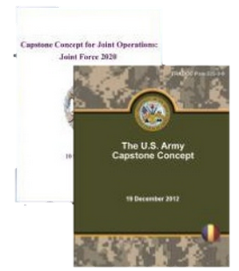

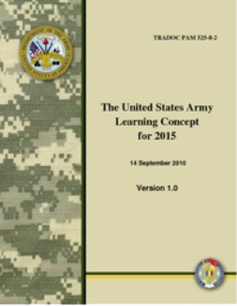
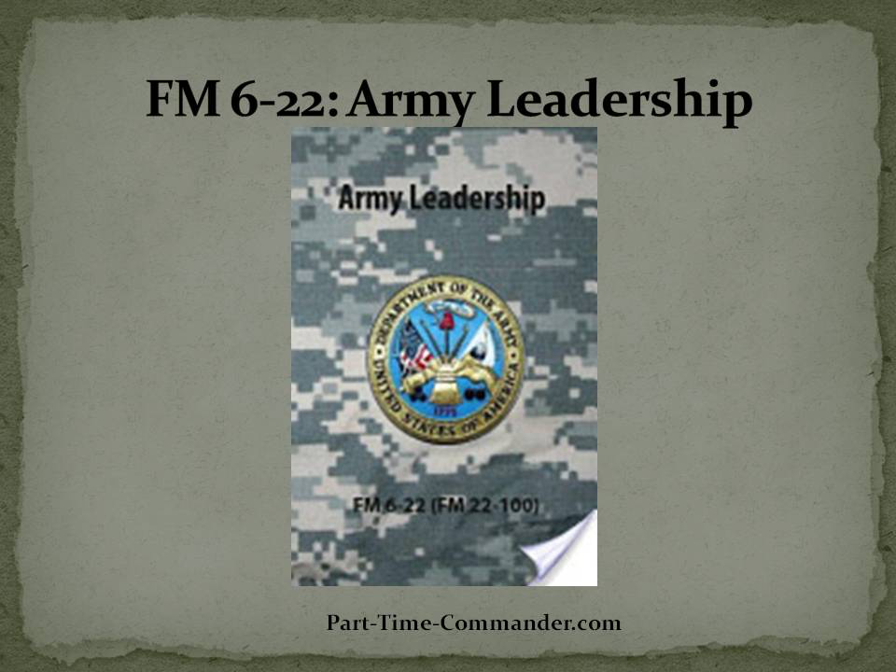
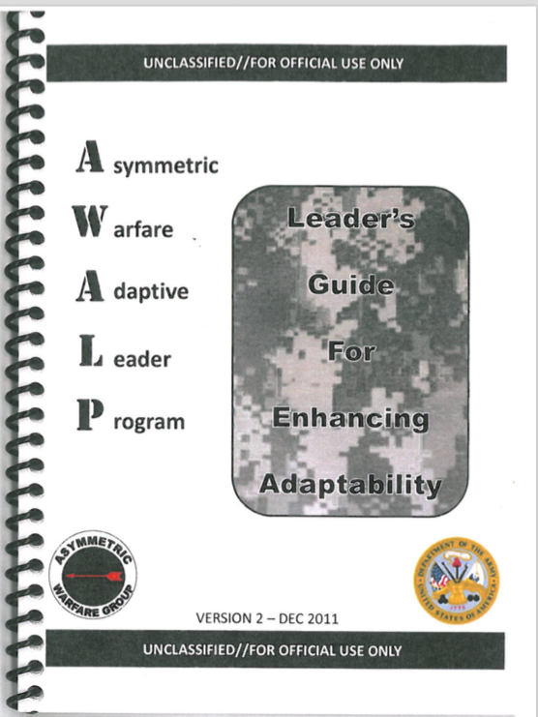
Approach: Refining and Nesting Adaptability
The fundamental characteristic of the Army necessary to provide decisive land power is operational adaptability -- the ability of Army leaders, Soldiers, and civilians to shape conditions and respond effectively to a broad range of missions and changing threats and situations with appropriate, flexible, and responsive capabilities.
Adaptability is responding to new needs or changes without a loss of functionality.
The Army will need to take deliberate steps to identify baseline skill levels essential for operational adaptability and outcome measures for each cohort and echelon.
Army Capstone Concept
Adaptability is an individual’s ability to recognize changes in the environment, identify the critical elements of the new situation, and trigger changes accordingly to meet new requirements.
Army Operating Concept
Adaptability has two key components. The ability of a leader to:
-- identify the essential elements critical for performance in each new situation.
-- change his practices or his unit by quickly capitalizing on strengths and minimizing weaknesses.
Army Learning Concept
Assessing Soldier Adaptability Study
Army
Leadership
Adaptability is an effective change in behavior in response to an altered situation while operating within the commander’s intent (AWG).
“Human performance technologies will help the Army develop adaptive leaders, resilient Soldiers, and cohesive teams that thrive in uncertain, dangerous, and chaotic environments.”
Army Operating Concept
Notes:
Illustration of the institutional context for the study of adaptable behavior. The reference to and notation of adaptability through these Army doctrine to the AWG definition speaks to the characterization of adaptability, its prevalence, and importance.
For the purposes of the Assessing Soldier Adaptability Study, the guiding definition of adaptability is based on the AWG definition …. READ what is in bold.
I’d also like to draw attention to the Army Operating Concept reference to human performance optimization in which adaptability is also referenced and specific examples of altered situations are provided.
Appendix B of AOC From Concepts to Capabilities: Building the Future Force
B-1. Introduction
Ensuring that future Army forces are prepared to win in a complex world requires a focused, sustained, and collaborative effort across the institutional Army, the operating force, the joint community, industry, academia, and other interorganizational and multinational partners.
Army Warfighting Challenges:
10) Develop agile, adaptive, and innovative leaders who thrive in conditions of uncertainty and chaos, and are capable of visualizing, describing, directing, leading, and assessing operations in complex environments and against adaptive enemies.

Slide 8
Phase 1: Findings
AWG Program Documentation:
OBTE Monograph
AWALP 1-8
RAND
Roselle Report
JHU/APL Primary Research:
Focus Group Interview
In-Depth Individual Interviews
Cadet Command Journal Evaluation
Cadet Command SME Observations
Qualitative, subjective assessment focusing on student satisfaction with the course content, course instruction, and the instructional approach.
Assessments of self-report adaptability and other attributes
The OBTE is an instructional methodology that teaches solider-leader attributes of which only one is adaptability.
OBTE is not synonymous with adaptability training
Focus Group: The AWG program is rich, complex and layered which makes isolation of measuring adaptive behavior difficult
Interviews:
Cadre: “Thinking creatively”, dealing with change, and “handling stress” were noted most frequently as critical to adaptability
Selection: Confirmed that adaptability can be identify and evaluated
Journals: Most frequently reported themes were the enabling dimensions (learning tasks, technologies, and procedures) relative to the core dimensions of adaptability.
Observations: OBTE approach creates conditions from which attributes can emerge
Notes:
Self assessments all occurred during the AWALP program. All past studies comingle adaptability with other concepts
All satisfaction based and response to the instructional program
Self assessment.. Satisfaction or self assessment of adaptability and other attributes
Presentation, approach, instructions
Qualitative and subjective
This distribution is understandable given that the participants were not informed to write specifically about anything, and therefore defaulted to discuss primarily what they learned during the day’s events
The selection interviews – confirmed that it can be measured. Supposedly they select more adaptive individuals

Slide 9
Phase 1: Conclusion
Gap: Adaptive behavior has not been directly or objectively measured
Based on AWGs Definition of Adaptability Definition:
Adaptability is an effective change in behavior in response to an altered situation while operating within the commander’s intent
Operational Definition:
Adaptive behavior is characterized by scoring high on specific military-relevant adaptive challenge and high self-regulation, as measured by psychophysiological indices, during adaptive challenge
Notes:
Adaptive behavior will be defined as an effective change in behavior characterized by individuals who score highly in adaptable performance and who show a high level of self regulatory response as measured by cardiovascular reactivity, skin conductance and neuroendocrine

Slide 10
Phase 2: Introduction and Objectives
Phase 1: The purpose of Phase 1 was to generate a comprehensive review of current program materials, prior assessment efforts/findings, interviews and field observations.
Phase 2: Execute a pilot study (n = 15-20) informed by the study of the state of the practice and recommendations from Phase 1.
“I feel more adaptable”
“You are more adaptable”
Understanding
Adaptability
AWALP 1-8
OBTE
Roselle
RAND
APL
Self Report and Survey Assessments
(Subjective)
Testable Quantifiable Metrics
(Objective)

Slide 11
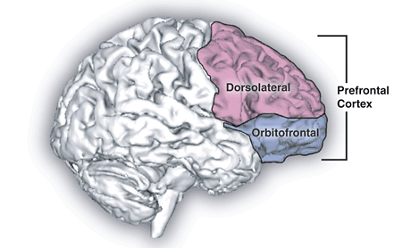
Phase 2: Background
Closing the Gap:
The second purpose of the JHU/APL observations was to identify assessment opportunities and candidate metrics of adaptive behavior
We identified executive function as a key underlying neuropsychological construct of adaptive behavior
Plan
Execute
Executive Function: is a family of top-down mental processes needed to concentrate, pay attention or flexibly adapt to changing behavioral requirements. Also called cognitive control.
It enables:
mentally manipulating ideas
processing information before acting
understanding relevant v irrelevant cues
meeting novel, unanticipated challenges
resisting temptation
staying focused
Represent
Evaluate
(Diamond, 2013; Gruber & Goschke, 2004; Koziol & Lutz, 2013)

Slide 12
Executive Function
Core executive functions: inhibition/interference control, working memory and cognitive flexibility
Inhibition/interference control means response inhibition, self-control, reduced impulsivity, overcoming deeply learned responses, maintaining selective attention and exhibiting cognitive inhibition
Working memory involves holding information in mind and manipulating it with new information from the environment or tasks and may require integration with knowledge stored in long-term memory (e.g., experience-based knowledge)
Cognitive flexibility builds on inhibitory control and working memory and is characterized by the ability to ‘think outside of the box,’ switch between task, and quickly and flexibly adapting to changing circumstances

Slide 13
Executive Function and Adaptive Behavior
Transfer knowledge, skills and/or solutions
Create novel solutions to novel challenge OR apply identified/known solutions to a novel challenge (context)
Integrate feedback to address new challenges
Anticipate and/or recognize consequences (feed-forward problem solving)
Organize and manage people, places and things, maintain high performance under high uncertainty or stressful conditions
Selectively focus (e.g., attention) on salient environment features and maintain focus on the ‘right thing at the right time’
Determine safe, practical, and elegant solutions
Create or facilitate collaboration for desired outcome
Ability to switch tasks while rethinking possibilities
Ability to determine relevant and correct information
Ability to maintain information with the presentation of new information
Ability to reason, problem solve and see patterns or relations among items
Ability to dissemble and recombine elements in a new way
Ability to selectively attend, focus on what one chooses, and suppress attention to other, potentially distracting, stimuli or information.
Ability to mentally reordering items, translating instructions into action plans, incorporating new information into one’s thinking or action plan (updating), and consider alternatives
Cognitive Flexibility
Understand the need for change
Inhibition
Adaptability
Carry out an effective change in behavior
Executive Function
Working Memory
Maintain the intent in carrying out the mission

Slide 14
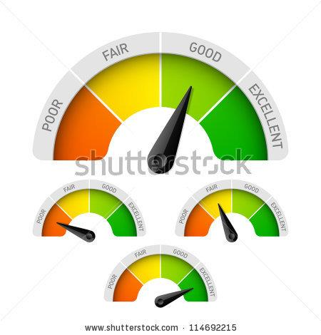
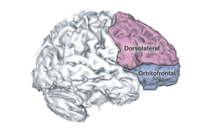

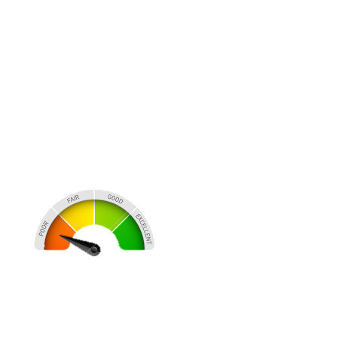
Phase 2: Purpose, Objectives and Hypotheses
The primary objective of this study is to determine objective metrics of adaptive behavior at the individual level via relevant neuropsychological assessments, performance on controlled, mission-relevant test tasks, and observation of psychophysiological responses during challenge.
1. High scores on the adaptive test task will be positively correlated with scores of the tests of executive function.
2. Lower scores on the adaptive test task will be associated with higher stress reactivity (less self-regulation) as indicated by higher HRV, skin conductance and neuroendocrine response

Slide 15

Study Design
Behavioral Assessments
Characterization of the population sample to include demographic information and military experience
Neuropsychological Tasks
Performance on scientifically rigorous standardized executive function tasks related to adaptability including cognitive flexibility, inhibition, and executive function
Multiple levels of measurement
Adaptive Test Task
Performance under stress while responding to authentic military situations
C^
C=
Cv
Consistency
IC^
IC=
ICv
Response Direction

Slide 16
Study Population
Healthy male and female adults aged 21-50 years who meet all of the following criteria will be included in the study:
Have (within the past 5 yrs) or are currently serving on active duty in the U.S. Army.
Held or currently hold the rank of E-5 (SGT), E-6 (SSG), E-7 (SFC), O-2 (1LT), O-3 (CPT), or O-4 (MAJ).
Selection Justification:
AWG identified a sample of leadership for which adaptable leader training would have the largest impact.
Individuals need to be capable of completing the test tasks
Variability on the adaptive test task will be attributed to differences in adaptable skill, not lack of understanding the task
Served or currently serve in an Army Combat Arms Military Occupation Specialty (MOS).
Have held a leadership position commensurate with their rank.
Have basic English proficiency.
Can use a computer and type to communicate a message
Willing to participate in a telephone screen.

Slide 17












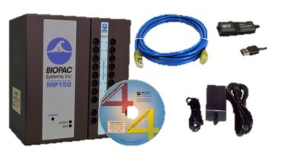
Study Population - Recruitment
JHU/APL Team generates study protocol and content
The Johns Hopkins
IRB reviews the study and approves it
AWG collaborator provides information to the Office of Public Affairs
Garrison Post Master Approves
Approved Emails are sent out
JHU/APL Team schedules lab session
JHU/APL Team conducts phone screens with interested individuals
Individuals either meet the screening criteria, or are excluded from the study
Possible population reviews the email and respond if interested
Lab session is conducted
Individual is unable to enroll in the study

Slide 18
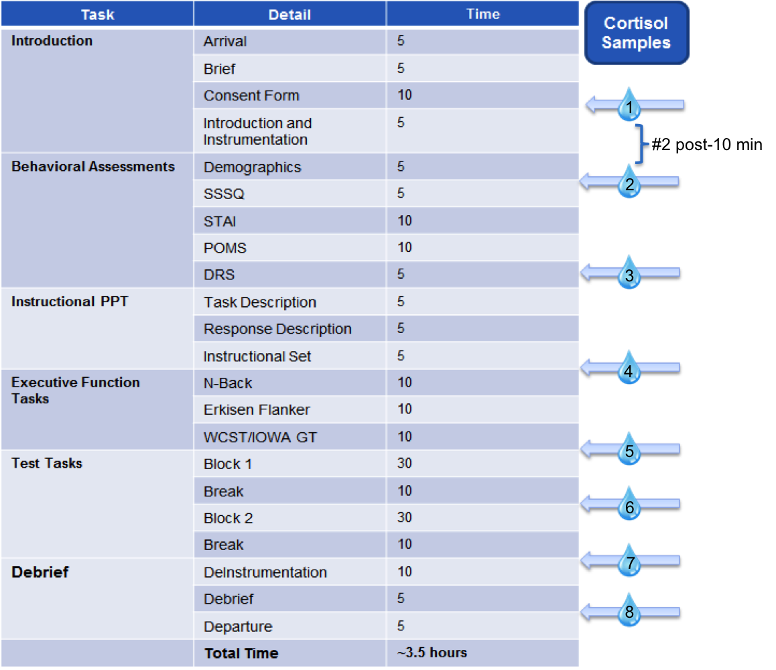
Testing Session Outline
Notes:
Add number of samples to cortisol drops

Slide 19
Behavioral Assessments
Demographics
Characterizes the population sample on health and military experience characteristics
Positive and Negative Affect Schedule (PANAS)
20 items, 5 pt scale
Shows relations between positive and negative affect and personality traits
The Short Stress State Questionnaire (SSSQ)
24 item
Measures stress state in task engagement
State Trait Anxiety Inventory (STAI)
40 item, 4 pt scale
Measures two types of anxiety
Anxiety about an event
Anxiety as a personal characteristic
Profile of Mood States (POMS)
65 items
Indicates how participant feels in general versus currently
Dispositional Resilience Scale (DRS)
45 items, 4 pt scale
Measures components of resilience: control, communication, strategy

Slide 20
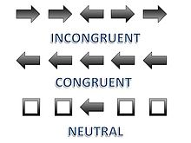
Executive Function Tasks: Inhibition Eriksen Flanker Task
Purpose:
Eriksen Flanker Task is a set of response inhibition tests used to assess the ability to suppress responses that are inappropriate in a particular context.
Methods:
The target is flanked by non-target stimuli which correspond either to the same directional response as the target (congruent flankers), to the opposite response (incongruent flankers), or to neither (neutral flankers)
There are three types of stimuli used:
Congruent stimulus- Flankers call for the same response as the target, and may appear identical. Also referred to as the compatible condition.
Incongruent stimulus- Flanker items call for the opposite response of the target and are represented by different symbols. Also referred to as the incompatible condition.
Neutral stimulus- Flanker items neither call for the same response nor evoke response conflicts

Slide 21
Executive Function Tasks: Working Memory N-back test
Purpose
Tests ability to quickly organize incoming and outgoing information (Kirchner, 1958)
Measures working memory. Multiple items must be kept in memory and continually updated (Owen, Mcmillan, Laird, & Bullmore, 2005).
Method
Images are flashed on a screen. Participant must remember previous images, and click the mouse when the current image matches the image two previous.
Scoring
Percentage of correct clicks
Average time taken to click

Slide 22
Executive Function Tasks: Cognitive Flexibility Wisconsin Card Sorting Test
Purpose
Measures cognitive flexibility. Changing contingencies require the participant to modify their behavior as a result of set-shifting (Monchi et al, 2001).
Method
Participant matches cards to one of a set of four. There are three possible criteria for matching (number, color, and shape). After a number of correct matches the matching rule changes, forcing the participant to adapt and reevaluate.
Stimuli
Feedback is provided after each match, enabling the subject to deduce the correct matching rule.
Scoring
Perseveration of preceding category
Participant sticks to preceding rule after the rule changes
Set-loss
Incorrect answer after 3 or more consecutive correct answers

Slide 23
Executive Function Tasks: Cognitive Flexibility Iowa Gambling Task
Purpose
Simulates real-life decision-making by incorporating uncertainty of premises and outcomes, as well as rewards and punishments (Bechara, Damasio, Damasio, & Anderson, 1994).
Methods
Participant has four decks of cards to choose from. The decks provide different levels of rewards and penalties. Successful players use trial and error to identify the best deck to draw cards from.
Stimuli
Each deck provides a fixed reward and occasional penalties.
Two decks provide net winnings, while the other two are net losers.
Scoring
The number of cards drawn from good decks minus the number of cards drawn from bad decks.

Slide 24
Iowa Gambling Task
Rules:
You will be asked to repeatedly draw cards.
You are free to draw from any of the four decks.
With every card you draw you will win some money.
Some draws will also impose penalties.
Some decks are more profitable than others.
Try to choose cards from the most profitable decks so that your total winnings will be as high as possible.
You will make 100 draws.
You start with $2000, and should try to make as much money as possible.

Slide 25
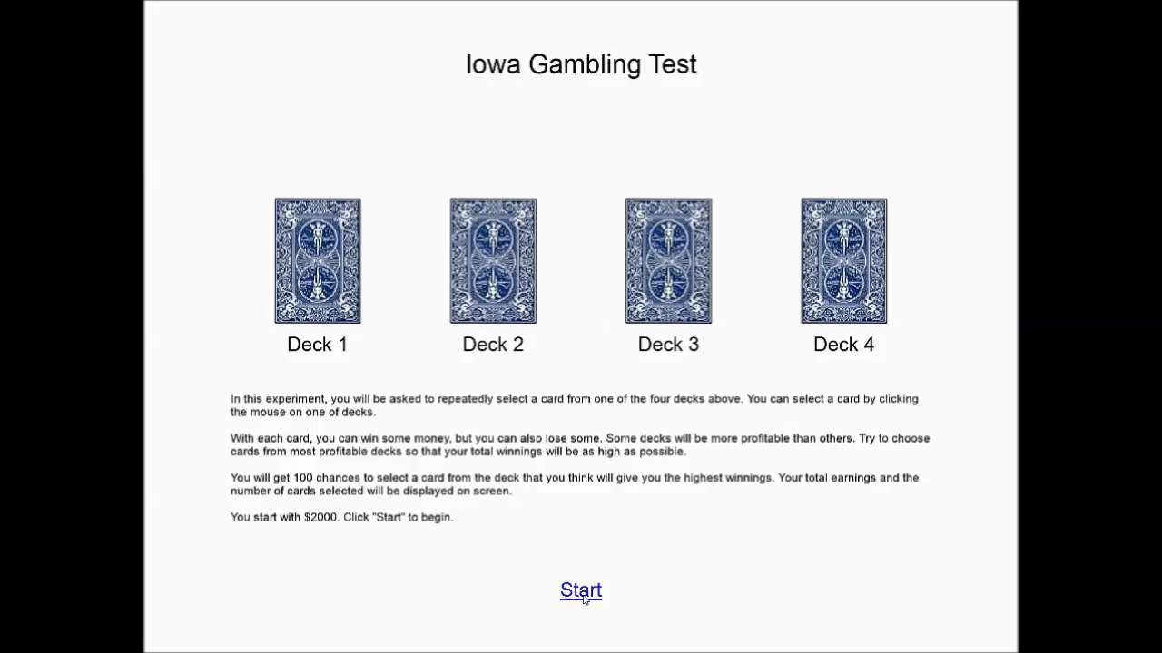
Demonstration

Slide 26
Adaptive Behavior Test Task – Trial Structure
Instructions
Mission Statement
Information
Pretrial Information
Once Per Block
+
Stimulus Prompt
Stimulus
Response
Prompt
Response
Trial Structure
Repeats 18 times
Event Marks
Pre trial response
Stimulus Emotional Response
Recovery from Stimulus
Stress from Responding
Areas of Interest
Notes:
Add in Demonstration after this

Slide 27
Test Task – Block Structure
Block 1
Combat
Operations
One Block = 18 trials
Block 2
Security Force Assistance
Set of Post Trial Questions
(Visual Analog Scale)
Subset of 6 trials

Slide 28



Different Signal Types
Block
Sub-block
Sub-block
Sub-block
Trial Structure
1
2
3
7
8
9
13
14
15
4
5
6
10
11
12
16
17
18
ECG – Sub-trial responses
Psychophysiological Signals
GSR – Sub-Block Responses
Different Signals give different information
Cortisol – Overall Block Recovery Responses

Slide 29
Outcome Data
Data Type | Data Source | Outcome/ Importance
Demographic Data | Basic self-reported demographic characteristics | Characterize the sample
Behavioral Assessments | Positive/Negative Affect Schedule (PANAS) Short Stress State Questionnaire (SSSQ) State Trait Anxiety Inventory (STAI) Profile of Mood States (POMS) Dispositional Resilience Scale (DRS) | Measure stress, anxiety, mood, and resilience disposition
Executive Function Tests | Iowa Gambling Test Wisconsin Card Sorting Test N-Back Eriksen Flanker | Tests decision making ability, cognitive flexibility, working memory, and response inhibition
Performance | Written responses to military test tasks | Adaptability to consistent and inconsistent stimuli in a military context
Psychophysiological | Electrocardiography (ECG) Galvanic Skin Response (GSR) Cortisol/α-Amylase | Measure increased and decreased stress, as both an immediate response, and over the study period
Self-reports | Written responses after completion of military test tasks | Individual’s perceived effectiveness, focus and confidence on the adaptability tasks

Slide 30


Planned Analysis
Standardized Assessments
Behavioral Assessment
Data will be sorted and organized in Excel and processed in SPSS
Executive Function
Adaptive Behavior Test Task scoring rubric
Written responses from each trial will be scored on a scale of 0 to 8.
A score of 4 is needed to qualify as an adaptive response
the word “approach” refers to both changes of tasks themselves and ways to overcome obstacles to accomplishing the same tasks
 | Identifies altered situation | Create new approach | New approach is appropriate | Explain new approach application | New approach meets mission purpose | New approach meets commander’s intent | Explains how new approach meets mission purpose | Explains how new approach meets commander’s intent | Total
Trial 1 | 1 | 1 | 0 | 0 | 0 | 0 | 0 | 0 | 2
Trial 2 | 1 | 1 | 1 | 1 | 1 | 1 | 1 | 0 | 7
Trail 3
Notes:
Demo – 2 slides
Response from trial 1
Response from trial 2
Audience engagement

Slide 31
Response
Review of Trial 1 Answer:
Please respond as if you were addressing someone ranked BELOW to you.
You have 30 seconds to input your response.
team leaders, we are changing our approach to clearing this compound because we found woman and children at the initial breech. We will now conduct a cordon and knock and NOT a deliberate assault. Do not use explosive breaching any more. We do not want to injure any civilians or upset them too much, and we need to ensure they are safe. Move PNF police to the front to assist interacting with the civilians. Ensure every section of the compound is clear and report any indication of enemy activity.

Slide 32
Response
Review of Trial 2 Answer:
Please respond as if you were addressing someone ranked ABOVE to you.
You have 30 seconds to input your response.
Tango 3, this is Alpha 6, the PRT leader refuses to be escorted by us, so we will just not let them leave the base unless our gun trucks are with them. Right now our operations is on hold.

Slide 33
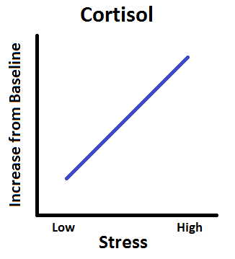
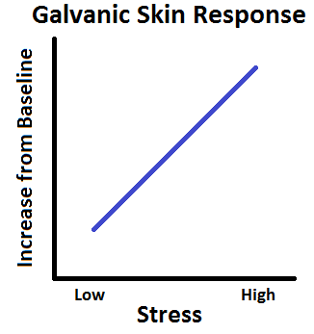
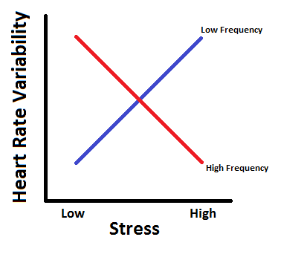
Expected Outcomes – Indicators of Stress
Psychophysiological Stress and Adaptive Performance
GSR, Cortisol and LFHRV correspond to high levels of stress
We expect to see these decrease with decreased performance

Slide 34
Expected Outcomes - Performance
Executive Function Tasks
For all executive function tasks (n-back, Eriksen Flanker task, Iowa Gambling Task, Wisconsin Card Sort Test)
Low stress yields high performance
Performance decreases as stress increases
Adaptability and Executive Function Performance
Low scores on the executive function tasks predict low adaptability
High scores on the executive function tasks predict high adaptability

Slide 35
Study Timeline
Tasks | June | July | August | September | Oct/Nov
Engineering Evaluation
IRB Approval
Recruitment
Study Deployed
Data Analysis
Draft Final Report
Refinement of Report
Final Report
Phase 3 Planning

Slide 36

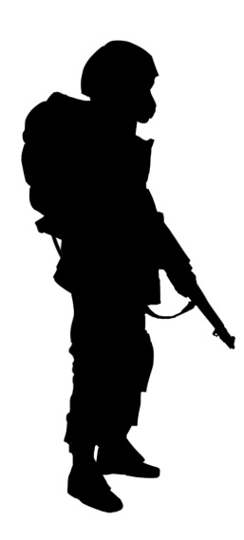
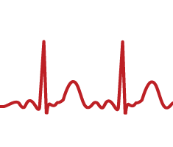





Phase 2 Outcome
Provided quantitative evidence that individual adaptive behavior can be measured and we have identified the metrics
Identified factors (executive function) that underlie individual adaptive behavior
Established a basis to enhance adaptive behavior at the individual level
Adaptability
AWG/APL Collaboration
“I know what it is
AND I can measure it”
“I know it when I see it”

Slide 37
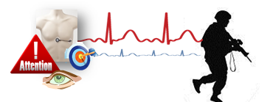
Phase 3: Authentic Military Sample
Objective: Deploy a full study of adaptability with a sufficient sample to achieve statistical power to include multiple levels of measurement across a variety of adaptive behavior challenges at a center of excellence (as facilitated by AWG)
Provides in-depth analysis of results, discussion, and implications to AWG and TRADOC

Slide 38

Necessary Partners for Transition
AWG
ARL
ARO
ARI
NATICK
CAC
Transition Process:
Identify partners for transition
Engage Network
Create a Roadmap

Slide 39

Questions/Comments?

Slide 40
Backup Content

Slide 41
Executive Function
Executive function (also called cognitive control) is a family of top-down mental processes needed to concentrate, pay attention or flexibly adapt to changing behavioral requirements.
Plan
It enables:
mentally ‘playing’ with ideas
taking time to think before acting
meeting novel, unanticipated challenges
resisting temptation
staying focused
Executive control depends on dynamic and context-sensitive interactions requiring multiple cognitive (prefrontal, frontal cortex), sensory (sensory association areas) and motor systems (parietal cortex) to support executive function.
Execute
Represent
Evaluate
(Diamond, 2013; Gruber & Goschke, 2004; Koziol & Lutz, 2013).

Slide 42
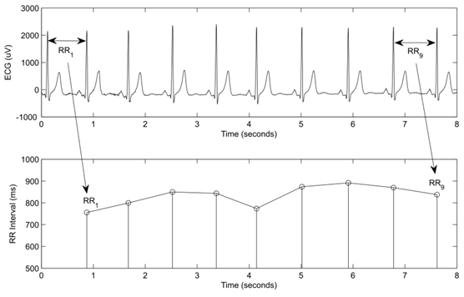


ECG and Heart Rate Variability (HRV)
The events that occur in the heart from one beat to the next beat are collectively referred to as the cardiac cycle
The wave of depolarization passing through the atrial muscle corresponds to the P wave in the electrical signal generated by the heart (ECG).
Heart Rate Variability can be defined as the physiological phenomenon of variation in the time interval between heartbeats.
Measured by the variation in the beat-to-beat interval. Other terms used include: "cycle length variability", "RR variability“.
Frequency domain methods assign bands of frequency and then count the number of RR intervals that match each band. The bands are typically high frequency (HF) from 0.15 to 0.4 Hz, low frequency (LF) from 0.04 to 0.15 Hz, and the very low frequency (VLF) from 0.0033 to 0.04 Hz.
High Frequency
Low Frequency
Ratio of High to Low Frequency
In healthy subjects, ratio between low and high frequency components (LF/HF ratio) of HRV spectra represents a measure of sympatho-vagal balance
Should we panic?
No, We’re good. We’ve done this before
Okay, cool.
Stress Adaptation

Slide 43
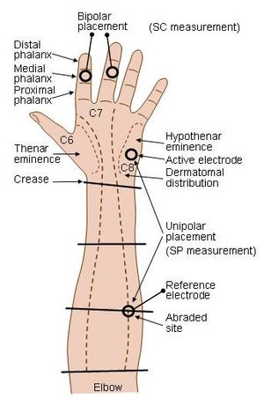
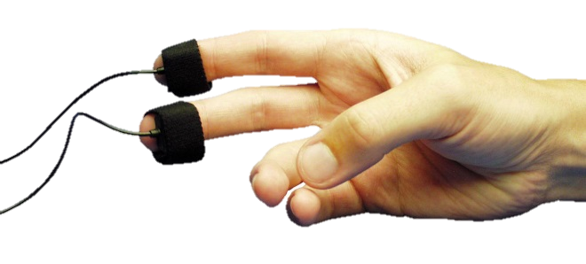
GSR
The Galvanic Skin Response (GSR) is defined as a change in the electrical properties of the skin. The signal can be used for capturing the autonomic nerve responses as a parameter of the sweat gland function. GSR can also be referred to as electro-dermal activity (EDA).
There is a relationship between emotional arousal and sympathetic activity, although the electrical change alone does not identify which specific emotion is being elicited. These autonomic sympathetic changes alter sweat and blood flow, which in turn affects GSR.
GSR is highly responsive to emotions in some people. Fear, anger, startled response, orienting response, and sexual feelings are among the reactions that may be reflected in GSR.
Well known uses for GSR include their use in the polygraph or lie detector test.
Boucsein, Wolfram (2012). Electrodermal Activity. Springer Science & Business Media. p. 2. ISBN 9781461411260. Retrieved 10 April 2015.

Slide 44
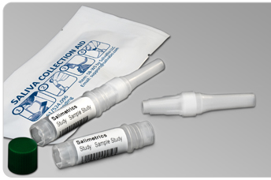



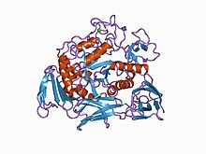
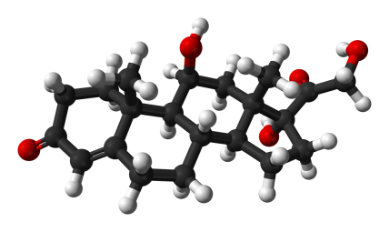
Cortisol/α-Amylase
Cortisol is a glucocorticoid hormone synthesized from cholesterol by enzymes in the middle area of the adrenal cortex
Regulated via the HPA axis, cortisol is the primary hormone responsible for the stress response.
Expressed at the highest levels in the early morning, cortisol’s main function is to restore homeostasis following exposure to stress
Finally, cortisol participates in an inhibitory feedback loop by blocking the secretion of corticotripin-releasing hormone, preventing the HPA axis interactions central to glucocorticoid secretion
chronic levels of high stress disrupt the delicate feedback balance, resulting in the failure of feedback inhibition to operate and the continued release of cortisol
http://dujs.dartmouth.edu/fall-2010/the-physiology-of-stress-cortisol-and-the-hypothalamic-pituitary-adrenal-axis#.VXheZ8_BzRZ

Slide 45




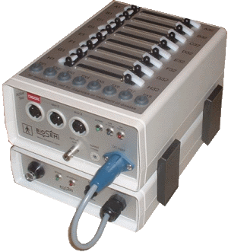
Instrumentation
Central Nervous System
Is this good or bad?
Stimulus
(Input from the Environment)
Understanding of Behavior
“What is the response?”
Autonomic Nervous System
Electrocardiogram (ECG)
Galvanic Skin Response (GSR)
Cortisol Response

Slide 46



Why Psychophysiology?
Psychophysiology encompasses much more than just the interactions between the heart and brain.
There are many signals that can be observed in the human body that can give important clues to the overall behavior.
Additional Signals include…
Electroencephalography (EEG) – Signals from the Brain
Galvanic Skin Response (GSR) – Signals from the Skin
Cortisol Response – Chemical signals from saliva
I’m stressed!
He’s trying to be social
“I’m all good!”
Differences in looking at an individual’s behaviors alone vs. looking at an individual’s psychophysiological signals
He’s trying to calm down
It is in combination that signals can give clues to how an individual will respond to a stimulus from the environment.
He’s stressed
This is important as sometimes how individuals respond is different to how they actually feel.

Slide 47
Phase 3: Potential Focus areas of Phase III
Does the AWG curriculum improve a soldier’s adaptable behaviors?
Is the AWG curriculum transferable? If a soldier attends AWG’s training – can it improve the adaptability of the entire unit?
Can adaptability scores be used to recruit better soldiers?
Can adaptability concepts be integrated into other TRADOC courses?
Are soldiers that have taken adaptability training more effective soldiers relative to those that have not taken adaptability training?

Slide 48
Extra Content

Slide 49
Study Outcomes – So What?
Understanding these underlying metrics of adaptability allows for a scientifically based focus on future training
Adaptability is difficult to train if not clearly defined – as it is preparing individuals to effectively change their behavior for the unknown
Matching performance on Executive function tasks to adaptability performance allows for trainers to obtain a baseline of individuals prior to their course – as well as gives them more options of areas to focus on (cognitive flexibility, inhibition, working memory) that are proven to have skill transfer
Cognitive Flexibility
Understand the need for change
Inhibition
Carry out an effective change in behavior
Working Memory
Maintain the intent in carrying out the mission

Slide 50
Adaptability
Physical Adaptability
Handling Crisis
Handling Stress
Interpersonal Adaptability
Learning Tasks, Technologies, Procedures
Thinking Creatively
Dealing with Ambiguity
Cultural Adaptability
AWG/APL Collaboration
I-ADAPT Model
“I know it when I see it”

